Slide 1
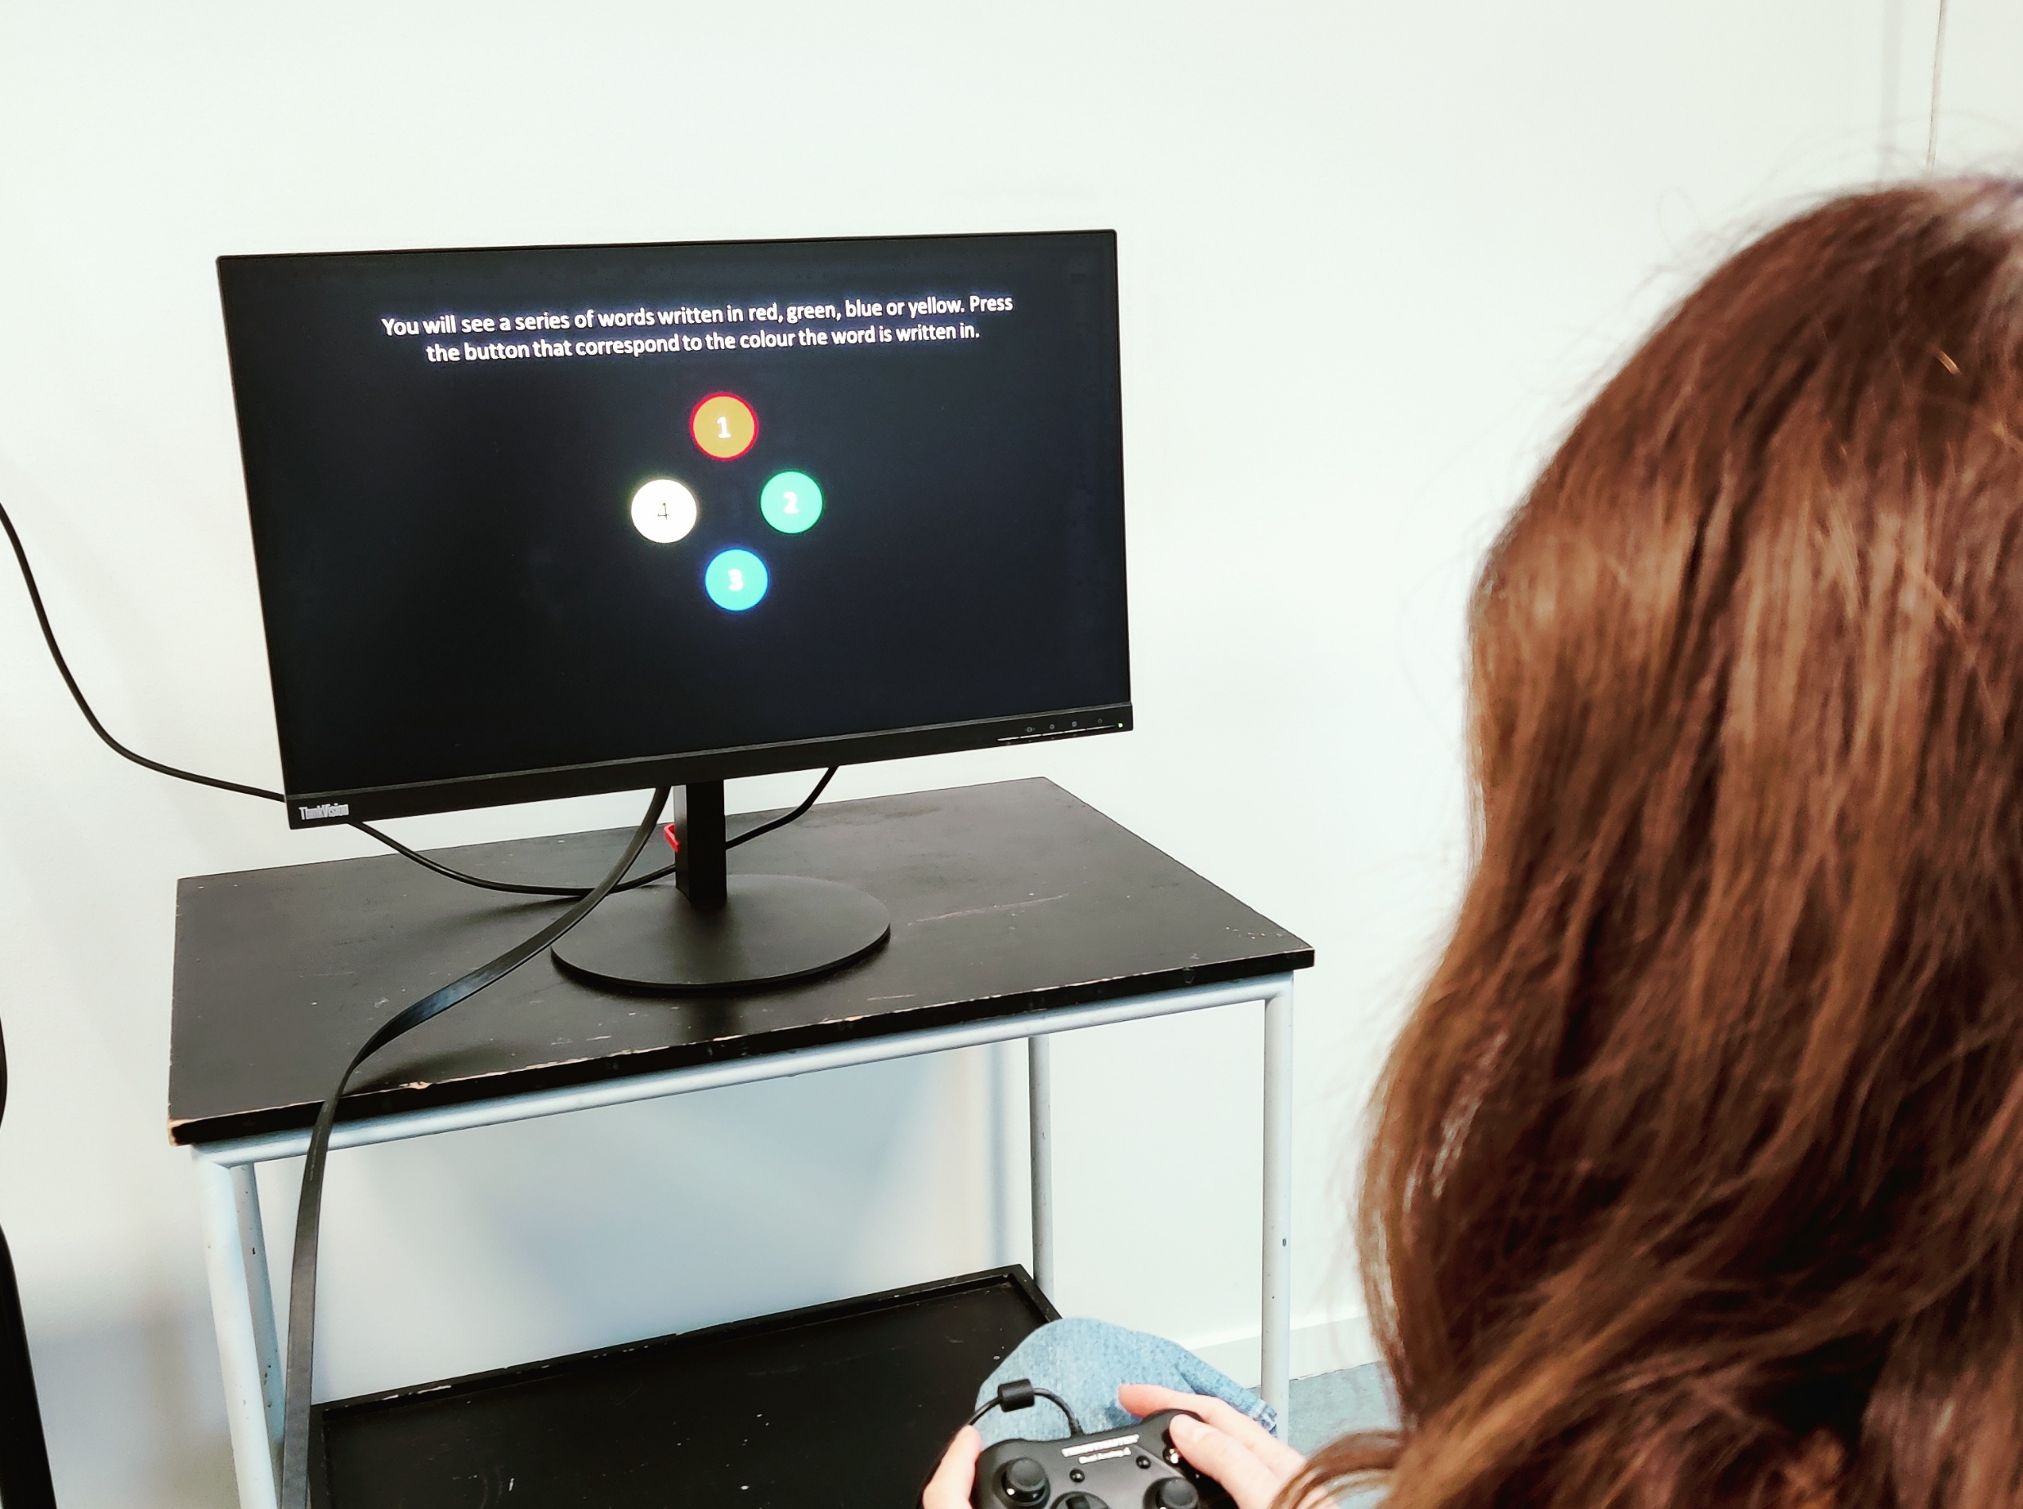

Stroop Task
Kristian Hennings
The Stroop Task is a measure of cognitive control and selective attention. In this task participants are shown colour words (e.g., "RED," "BLUE," "GREEN") printed in coloured ink. The task is to name the ink colour, not read the word. The task includes congruent trials, where the word and ink colour match (e.g., "RED" in red ink), and incongruent trials, where they mismatch (e.g., "RED" in blue ink). Incongruent trials create cognitive conflict, as the automatic process of reading the word interferes with naming the ink colour. This results in slower reaction times and more errors, known as the Stroop effect.
Notes:
How to shape the figure.
Place the photo below the blue shape.
Select the photo then the blue shape.
Then choose to merge shapes by Intersect

